Slide 1


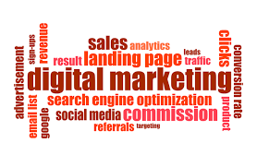
Digital Performance Accelerator: Unleashing Facebook Advertising Potential
XYZ Company
Team Members:
Anisha Singh (as229583)
Anurag Sahu (as229468)
Arushi Sethi (as228398)
Bindu Raghu Naga (br28722)

Slide 2
Business Story: Optimizing Conversions through Facebook Advertising
Business Question
Approach
Business Objective
Need for understanding the complexities of Facebook advertising and the allocation of advertising budgets
How can XYZ Company focus on Facebook campaigns to boost conversions and sales?
Align data-driven insights with XYZ Company's business aspirations, optimizing conversions and ad performance, while effectively managing the advertising budget
Emphasis on the customized data analysis approach to derive actionable insights for XYZ Company's distinct marketing strategies and objectives
Varying key performance indicators (KPIs) based on different business objectives, such as brand awareness or revenue maximization

Slide 3
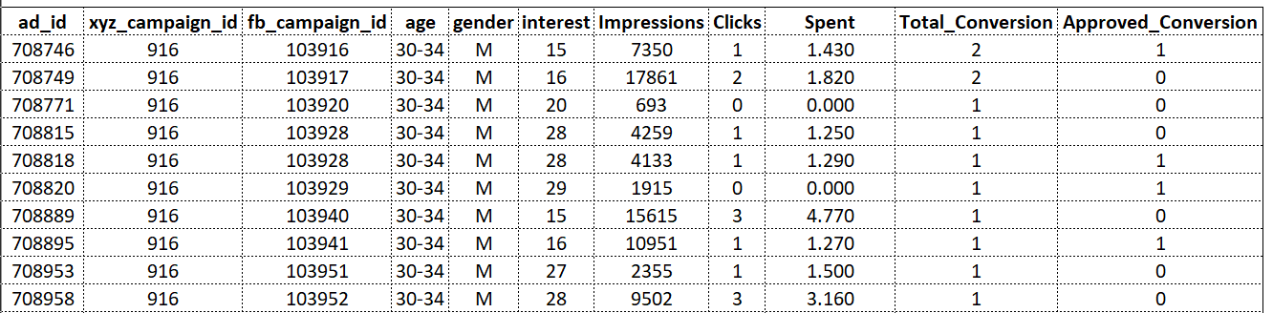
Overview of the Dataset
Variables | Description
ad_id | an unique ID for each ad
xyz_campaign_id | an ID associated with each ad campaign of XYZ company
fb_campaign_id | an ID associated with how Facebook tracks each campaign
age | age of the person to whom the ad is shown
gender | gender of the person to whim the add is shown
interest | a code specifying the category to which the person’s interest belongs
Variables | Description
Impressions | the number of times the ad was shown
Clicks | number of clicks on for that ad
Spent | Amount paid by company xyz to Facebook, to show that ad
Total_conversion | Total number of people who enquired about the product after seeing the ad
Approved_conversion | Total number of people who bought the product after seeing the ad

Slide 4
For certain crucial analysis, we performed feature engineering
Conversion Rate (CR)
CR quantifies the percentage of users who take action after viewing an ad
It helps assess the ad's effectiveness in motivating users to engage or make a purchase
Click-Through Rate (CTR)
CTR indicates the proportion of users who clicked out of the total ad viewers
It measures how well the ad captures users' interest, reflecting the ad's effectiveness in engaging the intended audience
Cost Per Click (CPC)
CPC measures the cost for each click generated by an ad
It helps evaluate the cost-effectiveness of acquiring user attention, indicating whether the spending on attracting users is economical
Customer Lifetime Value (CLV)
CLV is a vital metric that reflects the total anticipated revenue from a customer over their entire association with a company
It aids in identifying valuable customer segments, prioritizing marketing endeavors, and customizing strategies to ensure long-term profitability

Slide 5
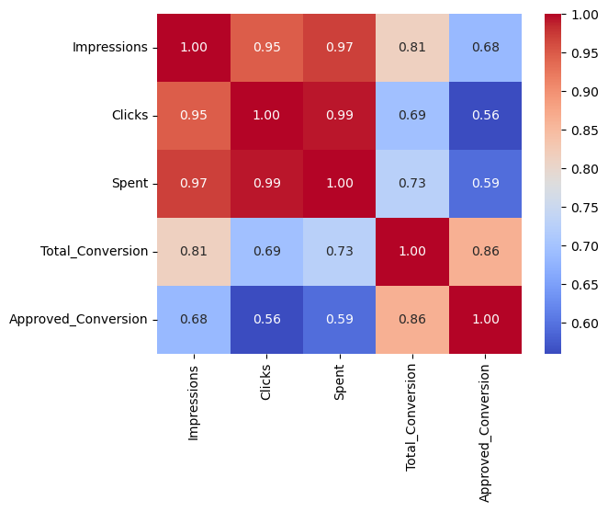
Understanding Ad Campaign Effectiveness: Correlation Analysis
Impressions and Approved Conversions exhibit a significant positive correlation, indicating that increased ad visibility leads to a higher likelihood of successful sales
Total Conversion also demonstrates a positive correlation with Approved Conversions, highlighting the importance of initial interest as a precursor to confirmed purchases
Clicks and Spent show weaker correlations with Approved Conversions, emphasizing the relatively diminished impact of these metrics on direct sales

Slide 6
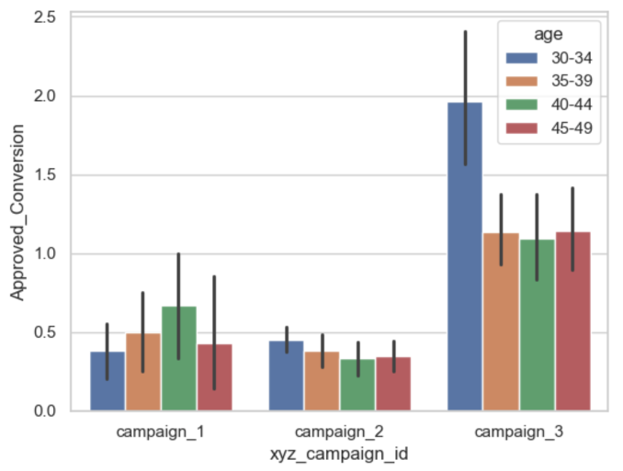
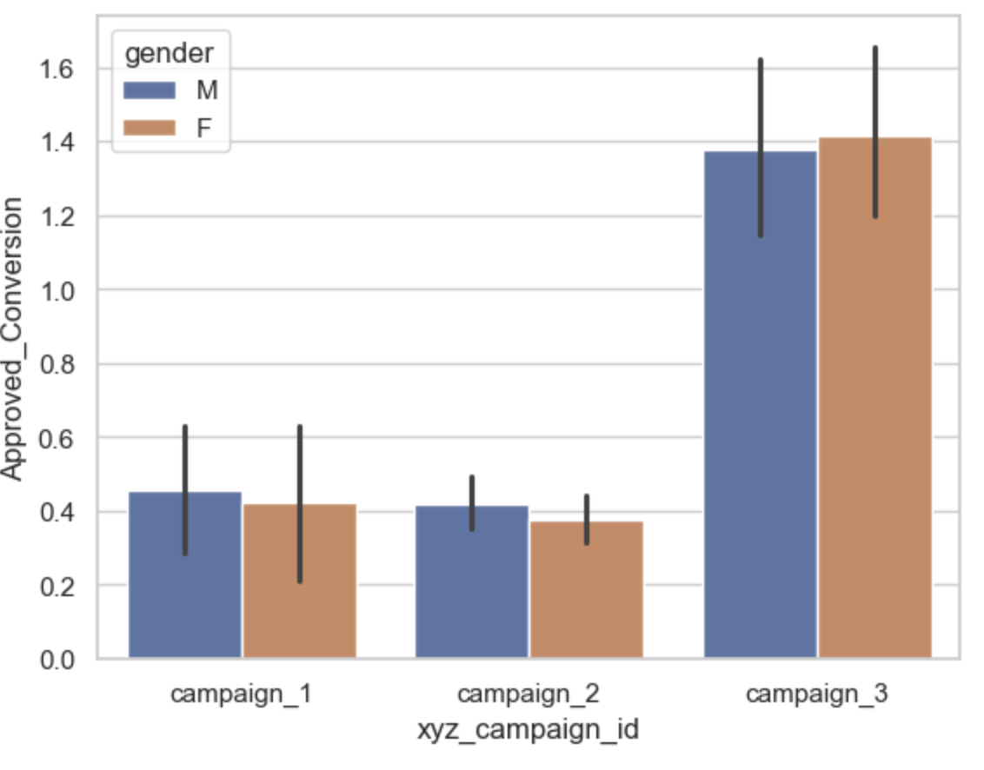
Examining Demographic Distribution across Three Campaigns
Campaign_2 and Campaign_3 show higher engagement from the 30-34 age group, while Campaign_1 performs notably better with the 40-44 age group.
Tailoring marketing strategies to specific demographics is crucial for optimizing campaign effectiveness, as highlighted by the distinct age group preferences across different campaigns
All three campaigns (campaign_1, campaign_2, and campaign_3) elicit similar levels of interest from both genders, with consistent engagement patterns observed.
The campaigns effectively capture the attention and interest of a diverse audience, indicating their ability to transcend gender-based differences in response.

Slide 7
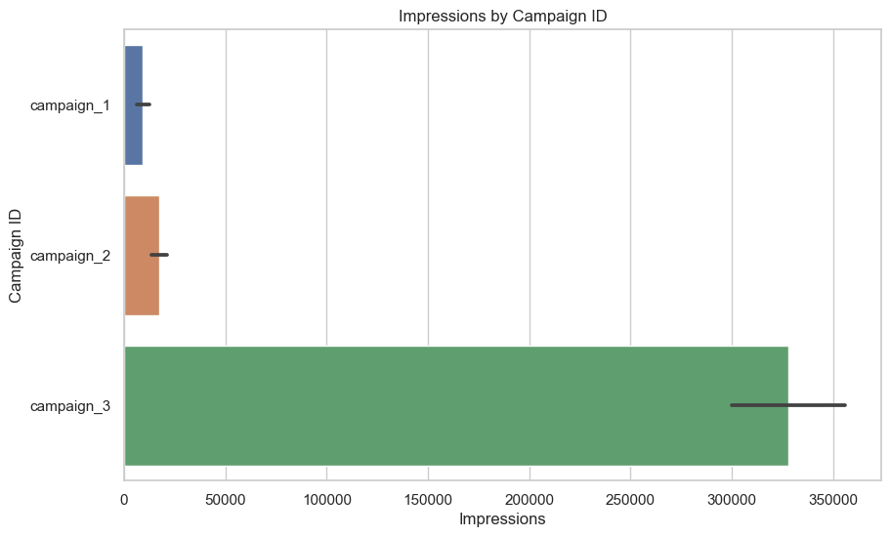
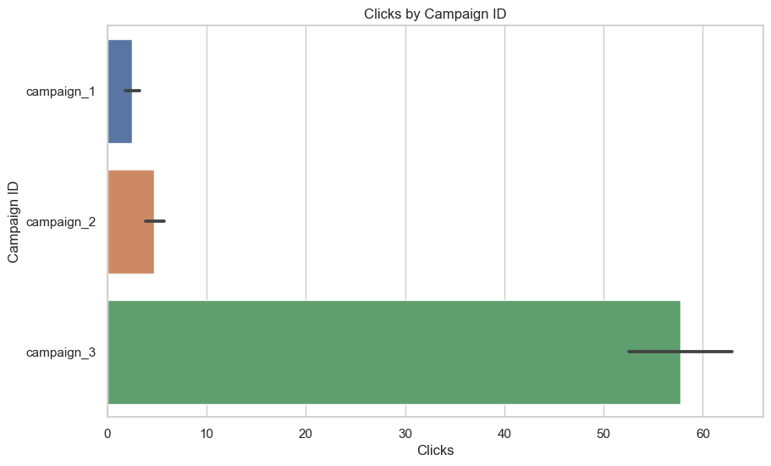
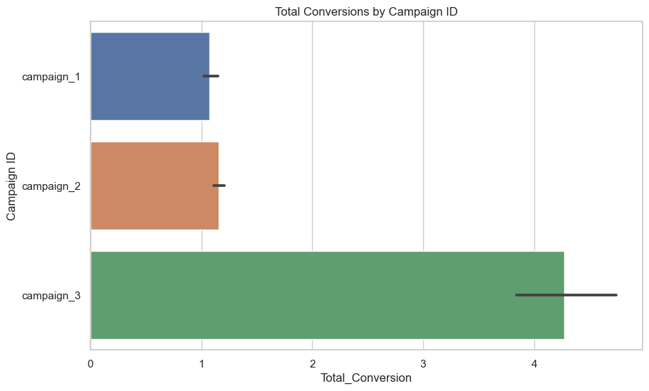
Campaign Analysis: Impressions, Clicks, and Conversions Distribution
Campaign 3 excels due to its larger budget, leading to greater audience reach and subsequently higher clicks and conversions.
Can we assert that Campaign_3 is the top-performing campaign based on the current analysis?
Can we predict if the other campaigns would perform equally well or better with the same level of funding, based on the current analysis?
NO! It's evident that campaign_3 surpasses its counterparts with considerably higher engagement and conversion rates.
Campaign_3's superior performance may be attributed to its larger budget, making it difficult to gauge whether the other campaigns could achieve similar or better results with equal funding.
C
To ensure a more precise assessment of the campaigns' actual performance, it is imperative to analyze the specified Key Performance Indicators (KPIs) - CR, CPC, and CTR, as previously stated
Implementing A/B Testing will provide a comprehensive understanding of the overall impact resulting from the increased budget

Slide 8
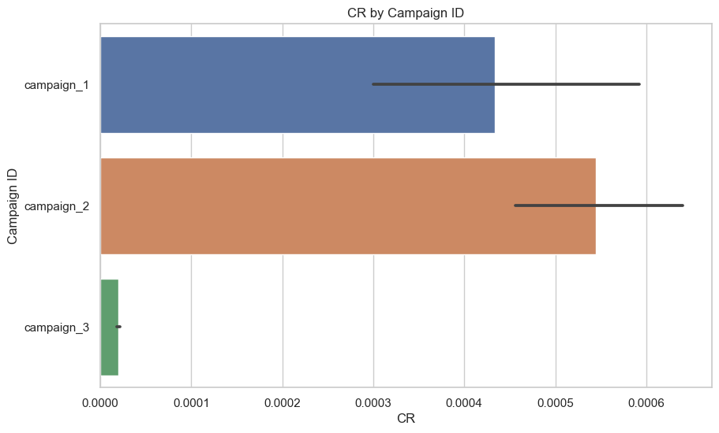
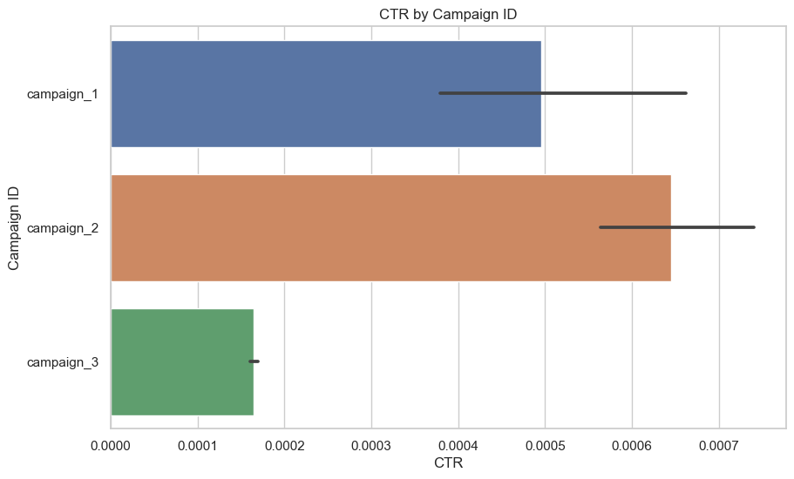
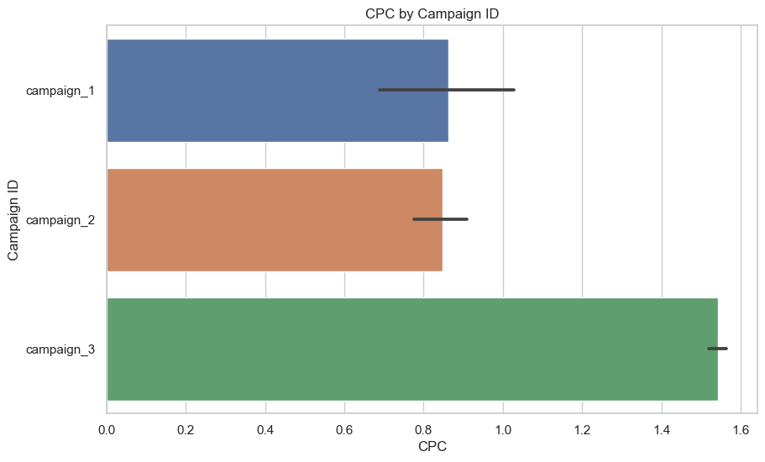
Campaign Analysis: CR, CTR, and CPC
Campaign 1
Campaign 2
Campaign 3
Holds an intermediate position, following campaign_2 in terms of mean CR and CTR
Shows relatively good performance in terms of cost-efficiency
Demonstrates the highest mean CR and CTR, surpassing campaign_1 and campaign_3
Shows promising cost-efficiency compared to the other campaigns
Records the lowest mean CR and CTR, despite having the highest mean CPC
Appears less cost-efficient in comparison to campaign_1 and campaign_2
Next Steps: Conduct pairwise comparisons (A-B, A-C, and B-C) to assess the statistical significance between the campaigns, and verify whether the observed differences in the KPIs are statistically significant

Slide 9
A/B Testing
Step 1: Checking if the residuals are normally distributed
Null Hypothesis (H0): Sample distribution is close to normal
Alternate Hypothesis: Sample distribution is not close to normal
Decision Rule: If p-value < 0.05, reject H0; if p-value > 0.05, cannot reject H0
p-values for Campaign 1, Campaign 2 and Campaign 3 for the three KPIs:
 | Conversion Rate (CR) | Click Through Rate (CTR) | Cost Per Click (CPC)
Campaign 1 | 5.96e-10 | 8.42e-11 | 7.76e-08
Campaign 2 | 4.15e-34 | 5.09e-34 | 2.58e-24
Campaign 3 | 1.21e-33 | 1.22e-05 | 1.30e-31
CR, CTR, and CPC for all three campaigns yield p-values much lower than 0.05, leading to the rejection of the null hypothesis. Consequently, the group residuals are not normally distributed for all three metrics, indicating non-normality across the campaigns.

Slide 10
Step 2: Checking for Variance Homogenity
Null Hypothesis (H0): Variance is homogeneous.
Alternate Hypothesis (H1): Variance is not homogeneous.
Decision Rule: If p-value < 0.05, reject H0; if p-value > 0.05, cannot reject H0
p-values using Levene’s Test for Campaign 1, Campaign 2 and Campaign 3 for the three KPIs:
 | Conversion Rate (CR) | Click Through Rate (CTR) | Cost Per Click (CPC)
p-value | 6.37e-29 | 9.04e-23 | 4.78e-83
The rejection of the null hypothesis, indicated by p-values less than 0.05, suggests non-homogeneous variance. Given the non-compliance with normality and variance homogeneity, the Mann-Whitney U test is suitable for further analysis across all KPIs

Slide 11
Step 3: Applying Mann Whitney U Test
Null Hypothesis: No difference in central tendency between groups
Alternate Hypothesis: Difference in central tendency between groups
p-values for Campaign 1, Campaign 2 and Campaign 3 for the three KPIs:
 | Conversion Rate (CR) | Click Through Rate (CTR) | Cost Per Click (CPC)
Campaign 1 | 0.43 | 0.95 | 0.79
Campaign 2 | 1.75e-133 | 5.77e-95 | 3.20e-76
Campaign 3 | 6.63e-31 | 8.02e-20 | 1.97e-18
Key Takeaways:
No significant difference for campaigns_1 vs. campaign_2 at 0.01667 significance level
Statistically significant differences found for campaigns_2 vs. campaign_3 and campaigns_3 vs. 1 in CR, CTR, and CPC
Emphasizes the need to address variations between campaigns 2 and 3, and campaigns 3 and 1

Slide 12
Long-Term Profitability Test: Customer Lifetime Value Analysis
Category | Category Type | CLV
Campaign ID | Campaign 1 | 2.77
 | Campaign 2 | 6.27
 | Campaign 3 | 89.26
Age Group | 30-34 | 36.04
 | 35-39 | 44.94
 | 40-44 | 55.10
 | 45-49 | 80.11
Gender | Female | 63.07
 | Male | 40.84
Campaign
Age Group
Gender
Campaign_1: Average CLV of approximately 2.77 units suggests a reasonable return on investment.
Campaign_2: Notably higher average CLV of around 6.28 units signifies better long-term value.
Campaign_3: Remarkable average CLV of about 89.26 units positions it as the most profitable campaign, warranting further analysis for insights into its success.
30-34 Age Group: Valuable demographic with an average CLV of 36.04 units.
35-39 Age Group: Showing potential for long-term profitability with an average CLV of 44.95 units.
40-44 Age Group: Higher value displayed with an average CLV of 55.11 units.
45-49 Age Group: Key target with the highest average CLV of 80.12 units.
Female: Higher average CLV of 63.07 units implies a greater lifetime value.
Male: Slightly lower average CLV of 40.84 units suggests room for tailored marketing strategies to engage male customers effectively.

Slide 13
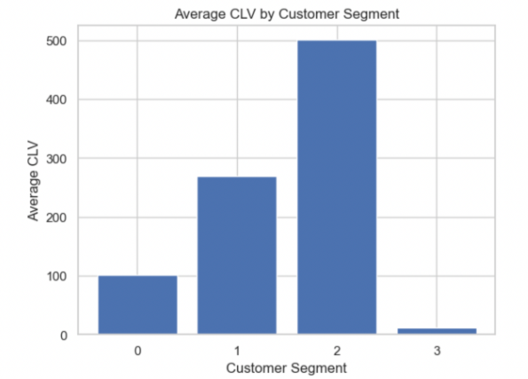
Customer Segmentation: K-Means clustering and Average CLV
Cluster 0
Cluster 1
Cluster 2
Cluster 3
Average CLV: 100.59 units
Customers with moderate CLV, indicating opportunities for growth.
Marketing strategies should focus on promotions, upselling, and cross-selling, utilizing data-driven marketing and analytics for further enhancement.
Average CLV: 269.21 units
Most valuable customers with the highest average CLV.
Tailored marketing efforts, loyalty programs, and excellent customer service are crucial for retaining and upselling to this group.
Average CLV: 500.79 units
Customers with exceptionally high average CLV, presenting a massive long-term profitability potential.
Specialized marketing campaigns, exclusive offers, and strong customer retention strategies can maximize revenue.
Average CLV: 12.12 units
Customers with the lowest average CLV, requiring dedicated analysis and targeted approaches for CLV improvement.
Re-engagement campaigns, targeted promotions, and understanding the reasons for lower CLV are essential to convert this group into higher CLV customers over time.

Slide 14
Conclusion
1. A/B testing highlights the superior performance of campaigns_1 and _2, emphasizing the need for cautious scaling to accommodate potential changes at a larger audience scale.
2. Campaign_3's large reach and conversion numbers are juxtaposed with its efficiency, warranting an investigation into its limited engagement, given its broader exposure.
3. Targeting the 30-34 age group for enhanced user engagement is recommended, with a call for further investigation into other age groups exhibiting lower ad interactions.
4. CLV analysis highlights Campaign_3, 45-49 age group, and female customers for profitability. Aligning strategies fosters enduring customer relationships, emphasizing CLV's role in informed decisions and better experiences.

Slide 15
Recommendation
1. Valuable insights from the analysis provide guidance for future decision-making and strategy development
2. Integration of additional data sources and understanding the customer journey beyond initial clicks are essential for comprehensive campaign performance evaluation.
3. Remarketing and retargeting opportunities are evident, emphasizing the significance of nurturing leads over time and maximizing campaign impact
4. Data-driven marketing aligned with clear business objectives is vital for informed decision-making, ultimately leading to enhanced return on investment and improved long-term success, including optimized CLV

